Slide 1
FAO Stock Assessment T5.1
Anton Ellenbroek, Yann Laurent, Enrico Anello - FAO
BlueBRIDGE 4° TCom meeting
07-10 March 2017
Copenhagen, Denmark

Slide 2
Topics
Regional Database
Priority models
Vizualization

Slide 3
Regional Database
To collate (third party) country data from excel applications in a shared and harmonized Caribbean Database

Slide 4
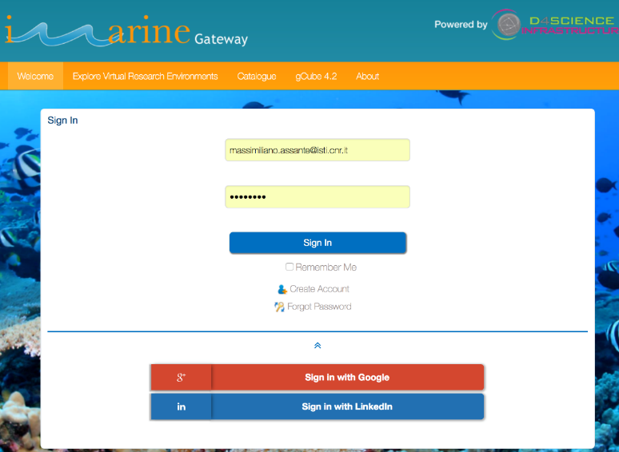
RDB data COLLATION tool
Collation: Few users, preformatted tables
Catch and effort (species, sites, gear, etc)
Users are not IT Staff but “users”

Slide 5
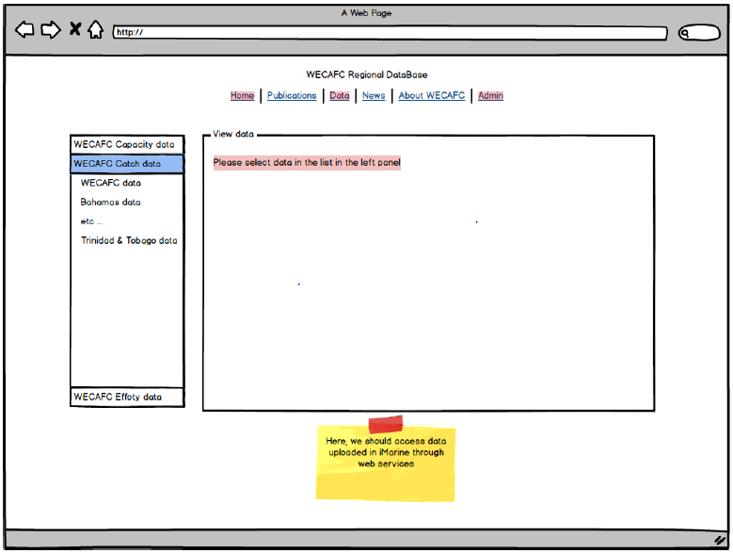
A template driven data flow

Slide 6
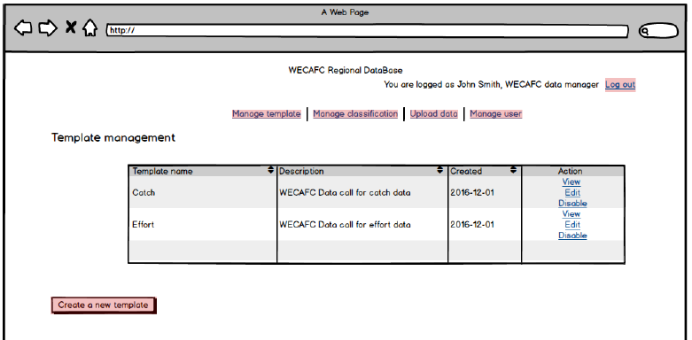
Pre-defined templates for end-users

Slide 7
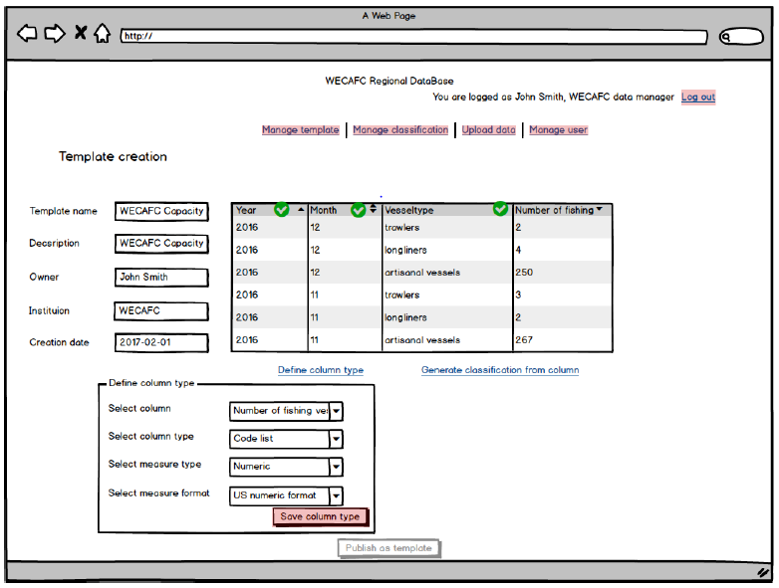
Only allow data that fits template Reject anything that misfits

Slide 8
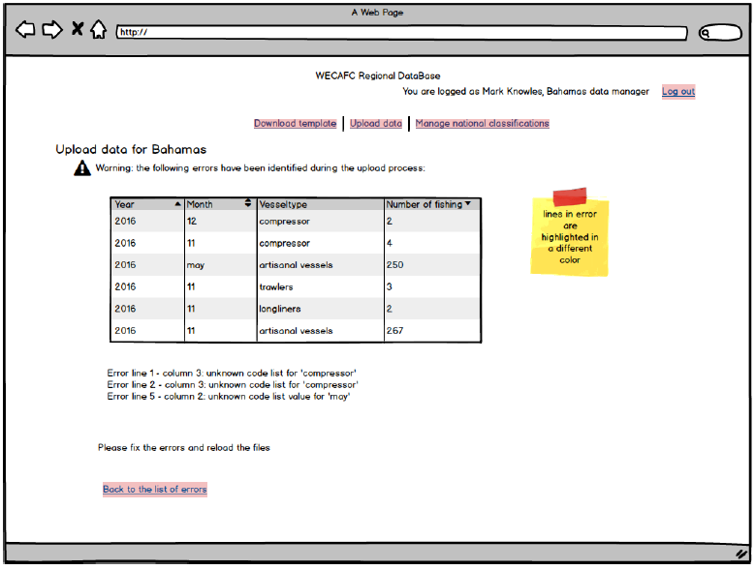
Bad data: Good message Help users understand their mistakes

Slide 9
Priority Models
To analyze user uploaded content, TabMan queries, R-data or WS data with any programming language

Slide 10
Everything has priority
CMSY – Support also external view
SS3 – in FAO (there will also e IRD; TBD)
FLR – Requested through EAB meeting (Osio)
DLM Tool - (FAO follows ICES; new person)

Slide 11
Vizualize output
To present data in embeddable web portlets to share D4Science content as wide and far as possible
This is asked by the communities to get “something” in return
IRD and Fao are developing OpenCPU based viewers

Slide 12
Vizualization
CMSY R-Notebooks
OpenCPU
Webviewer

Slide 13
Vizualization Plan
Having facilities to easealy build up front-ends, internally and externally, to the e-infrastructure.
Having facilities to build up reports based on DataMiner algorythms.

Slide 14
Vizualization Progress
Rstudio Notebooks to generate basic CMSY reports based on Rcode that connects to the WPS and runs the CMSY algorythm.
Working on the SS3 integration with NOAA/WECAFC
Working with IRD on visualization tools based on OpenCPU/WPS.
At the moment there we miss dynamics that we are trying to compensate using ad-hoc Rcode disseminated by the Data Miner even though the OpenCPU approach might be preferable.

Slide 15
Vizualization Actions
OpenCPU clustered in the e-infrastructure with facilities to let users install their own packages (like in Rstudio instances)
Usage of Rstudio Notebooks available since Rstudio version 1.0 (currently version 0.99 is available in the RPrototypeLab)

Slide 16
Hav en god dag

